Slide 1
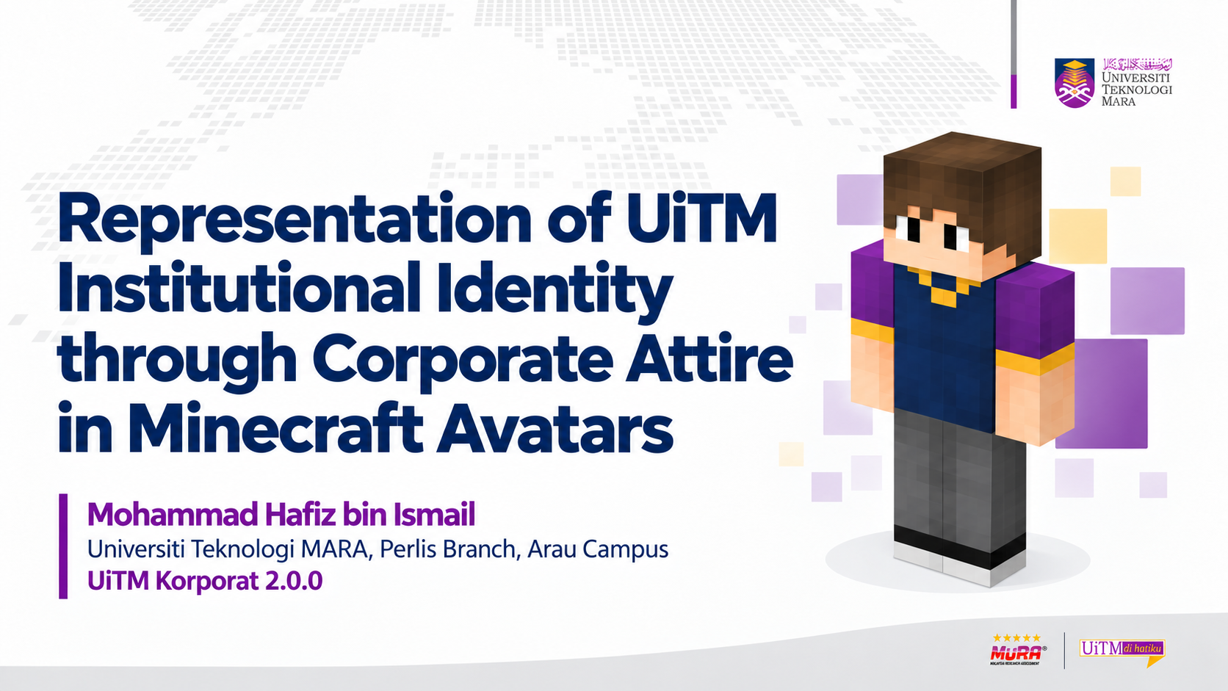
Notes:
This presentation examines how institutional attire can be represented through Minecraft avatars. The case is UiTM Korporat 2.0.0, a collection of 21 Minecraft Bedrock skins and a public web preview studio developed by Mohammad Hafiz bin Ismail at UiTM Perlis.
The contribution is a documented digital artifact and its implementation workflow. We will look at the design rationale, how texture assets retain their intended geometry, what the preview allows a user to inspect, and what the available technical evidence supports. The paper does not report a participant study, so claims about recognition, collaboration or learning remain questions for future evaluation.
Source: M. H. bin Ismail, “Representation of UiTM Institutional Identity through Corporate Attire in Minecraft Avatars,” 2026, https://mypapit.net/pub/pdf/representation-uitm-institutional-identity-corporate-attire-minecraft-avatars.pdf. The illustrative avatar is a schematic, not an additional source screenshot. Source paper © 2026 Mohammad Hafiz bin Ismail, CC BY-SA 4.0, https://creativecommons.org/licenses/by-sa/4.0/. This presentation is an adaptation under the same licence.

Slide 2
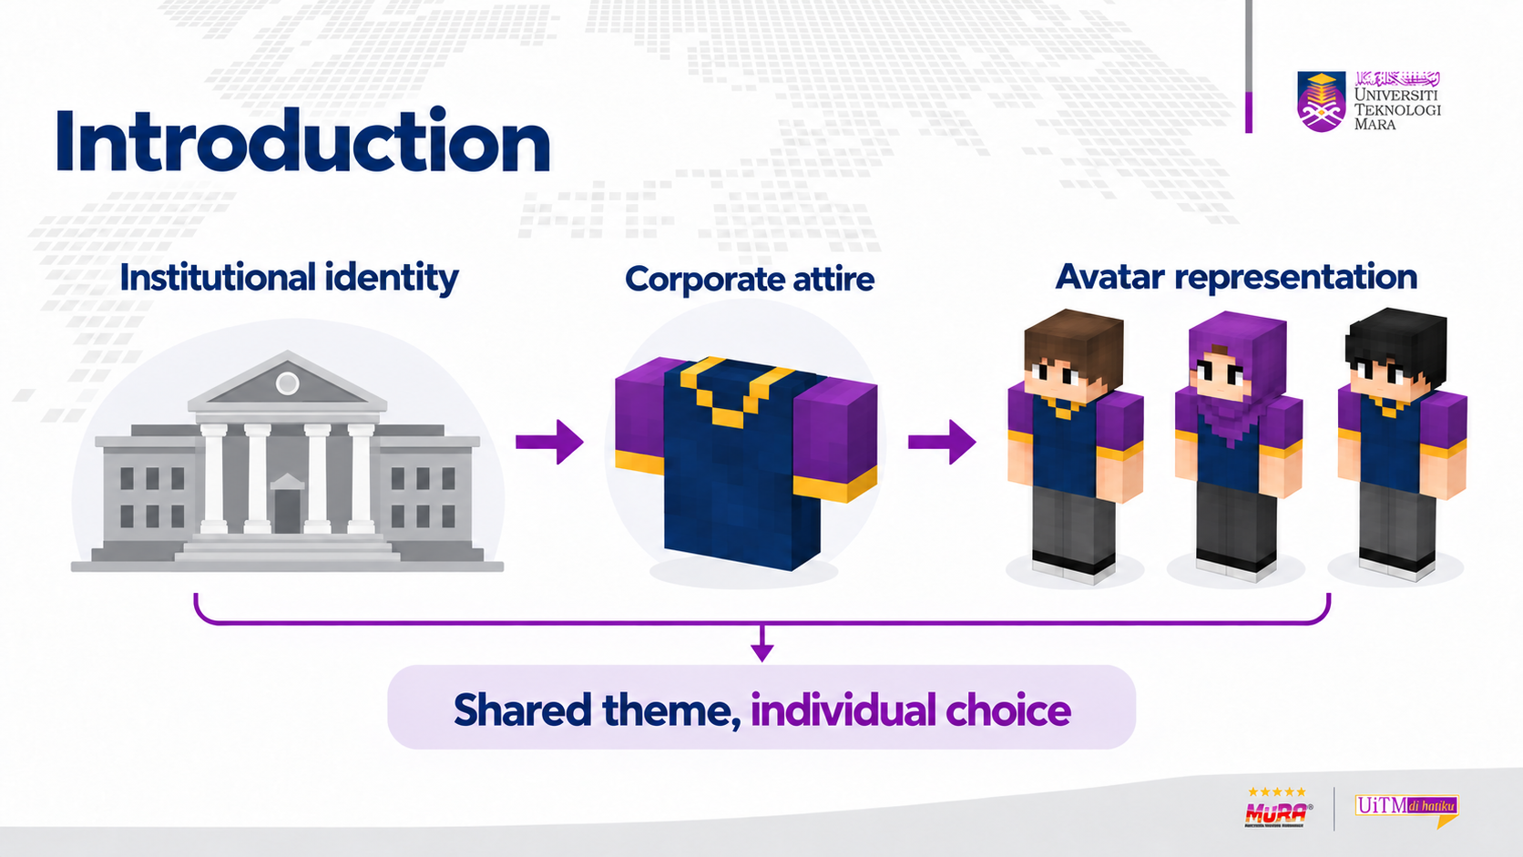
Notes:
The diagram starts with the institution, moves through its corporate attire, and ends with avatar representation. The central design problem is to carry recognisable garment cues into the constraints of a block character while keeping a useful range of individual choices.
The paper treats corporate clothing as a visual reference for university-associated activity. Colour placement and garment themes can be shared across characters, while hair, headwear, facial details and robes provide selectable differences. The design offers a common visual theme without requiring every avatar to be identical.
The final link is representational: the collection depicts an institutional theme. Whether other players reliably recognise that theme needs to be tested. The next slide explains why the combination of shared appearance, personal selection and preview inspection motivated the artifact.
Source: paper, Section I and Section II-A. Prior appearance/group-identity rationale: Martey and Consalvo (2011), doi:10.1080/15405702.2011.583830, as discussed in the source paper. The diagram is an explanatory adaptation rather than an empirical result.

Slide 3
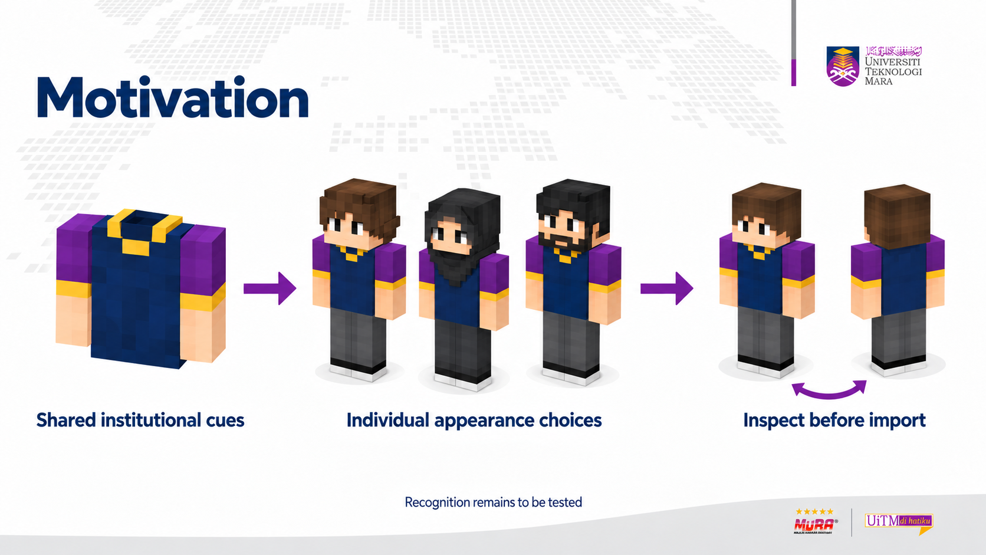
Notes:
Three related design needs motivate the work. First, shared garment cues provide a consistent institutional reference. Second, users can select among different appearances within that reference. Third, a preview can expose parts of the clothing that a thumbnail leaves hidden before a skin is imported into the game.
The paper connects these decisions to earlier research on avatar customisation and context-dependent clothing. Those studies provide a rationale for the design. They do not demonstrate an effect of UiTM colours or show that this particular studio improves selection. The paper also draws on research about interactive product presentation to motivate appearance inspection.
UiTM’s attire specifications give the adaptation concrete constraints: prominent colours, stripe patterns and emblem positions. Together, these considerations lead to the specific collection and workflow introduced next.
Source: paper Sections II and III-C. Prior work discussed there: Fu et al. (2025), doi:10.1145/3706598.3713262; Triberti et al. (2017), doi:10.1089/cyber.2016.0424; Jiang and Benbasat (2007), doi:10.2307/25148804. These references are cited through the paper, not independently re-evaluated here. UiTM attire specification is source-paper reference [2].

Slide 4
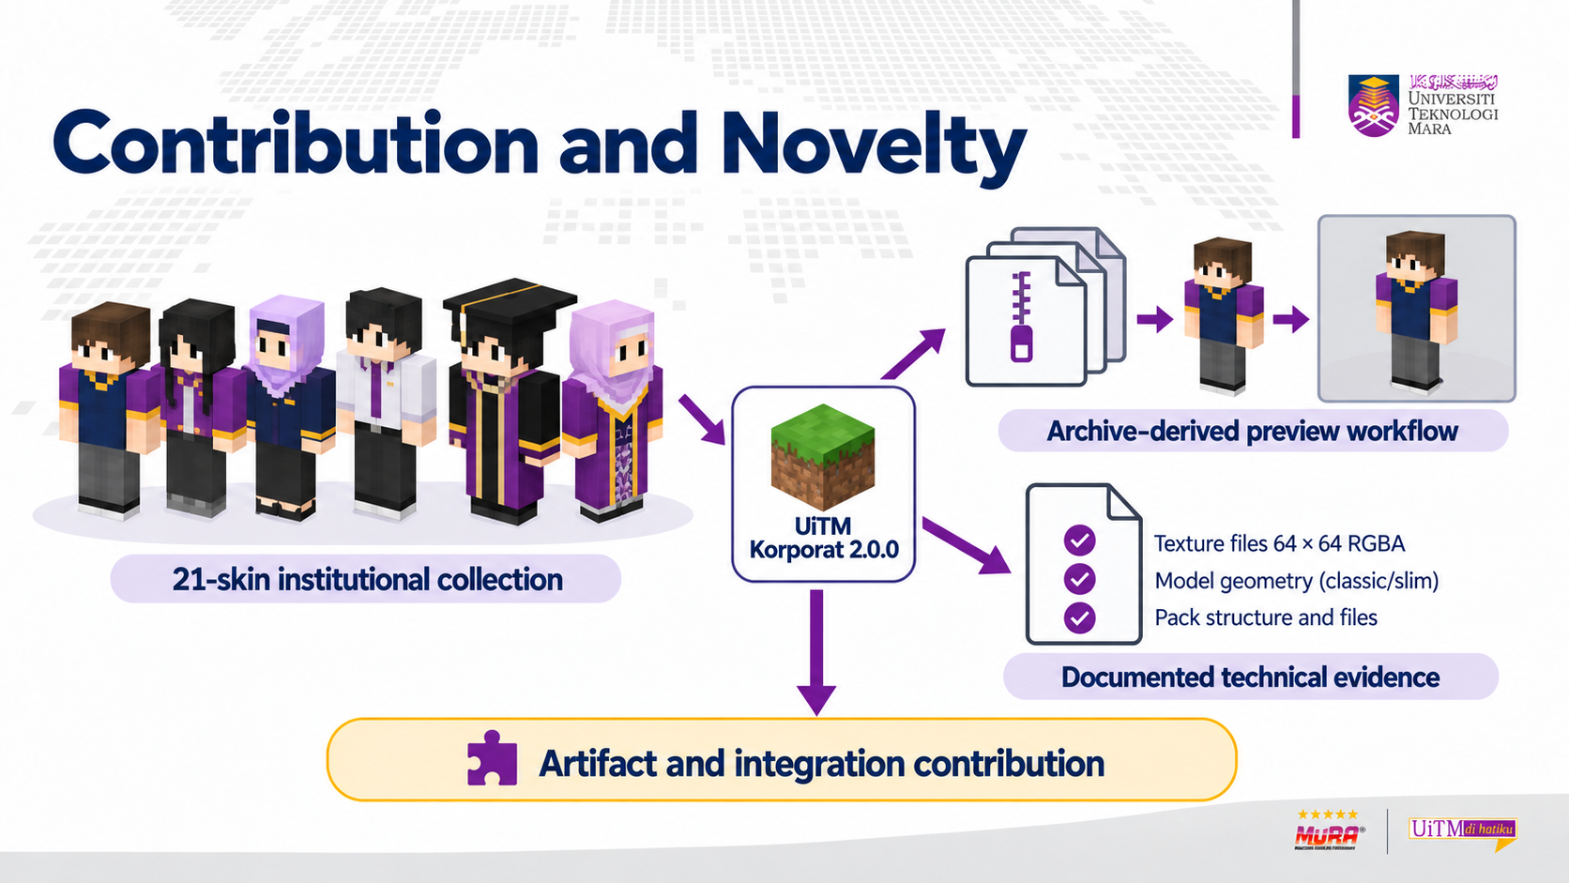
Notes:
The contribution combines three parts. The first is a complete catalogue of 21 institution-themed skins, preserving their original names and documenting their observed appearance. The second is an archive-derived workflow that carries textures, declared geometry and catalogue labels into a public preview while preserving original downloads. The third is the technical account supported by archive inspection, animation tests, development records and gameplay illustrations.
The novelty is therefore situated in this institutional artifact, its integration and its documentation. The implementation uses established packaging and rendering tools. The paper does not claim a new rendering algorithm, and this presentation makes no first-ever claim.
The visual clusters are schematic representations of these contributions. We now turn to the paper’s design rationale, starting with the visible garment cues.
Source: paper Section I, Section III, Table I and Section VI. The depicted avatar cluster is illustrative and is not the complete catalogue of 21 original skin assets.

Slide 5
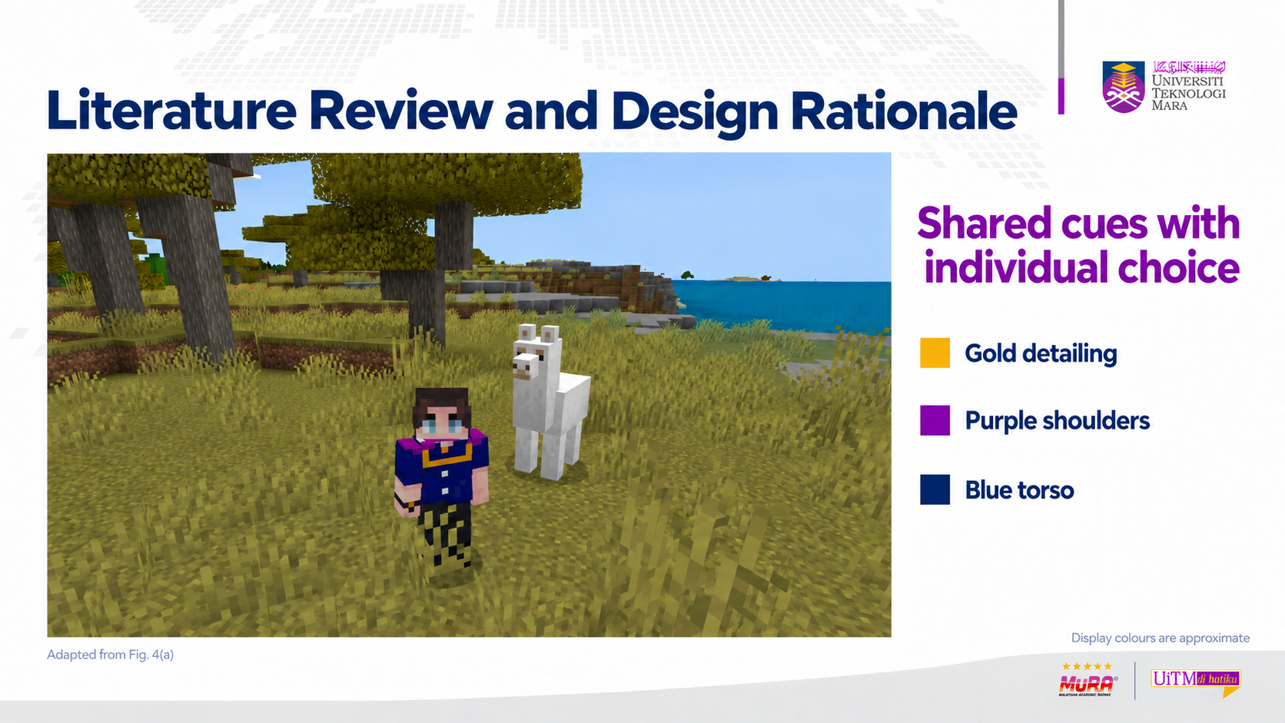
Notes:
The screenshot shows how corporate attire appears in an actual Minecraft environment. The colour key directs attention to the blue torso, purple shoulder regions and gold detailing. Those prominent garment cues are suitable for a small texture where fine seams and lettering cannot retain their physical detail.
The corporate-attire reference names Pantone 130C, 254C and 655C. The paper explicitly cautions that digital RGB approximations and scene lighting cannot establish a calibrated Pantone match. The slide therefore identifies visible colour regions rather than claiming colour calibration.
Prior avatar research motivates the combination of shared appearance and selectable differences. Hair, beards, headscarves and robes distinguish characters while maintaining an institutional theme. This screenshot is evidence of visible appearance, not proof that an observer recognises UiTM. Its exact selected skin identifier is absent from the supplied record.
Source: paper Section II and Fig. 4(a). The source screenshot was supplied by the author. The slide adapts that image with surrounding labels through the selected image-generation backend; it is not a pixel-identical reproduction. The unchanged source figure remains available in assets/figures/fig4a-corporate-gameplay.png. Prior identity literature is source-paper references [1], [5]–[8]. © 2026 Mohammad Hafiz bin Ismail, CC BY-SA 4.0; adapted with attribution.

Slide 6
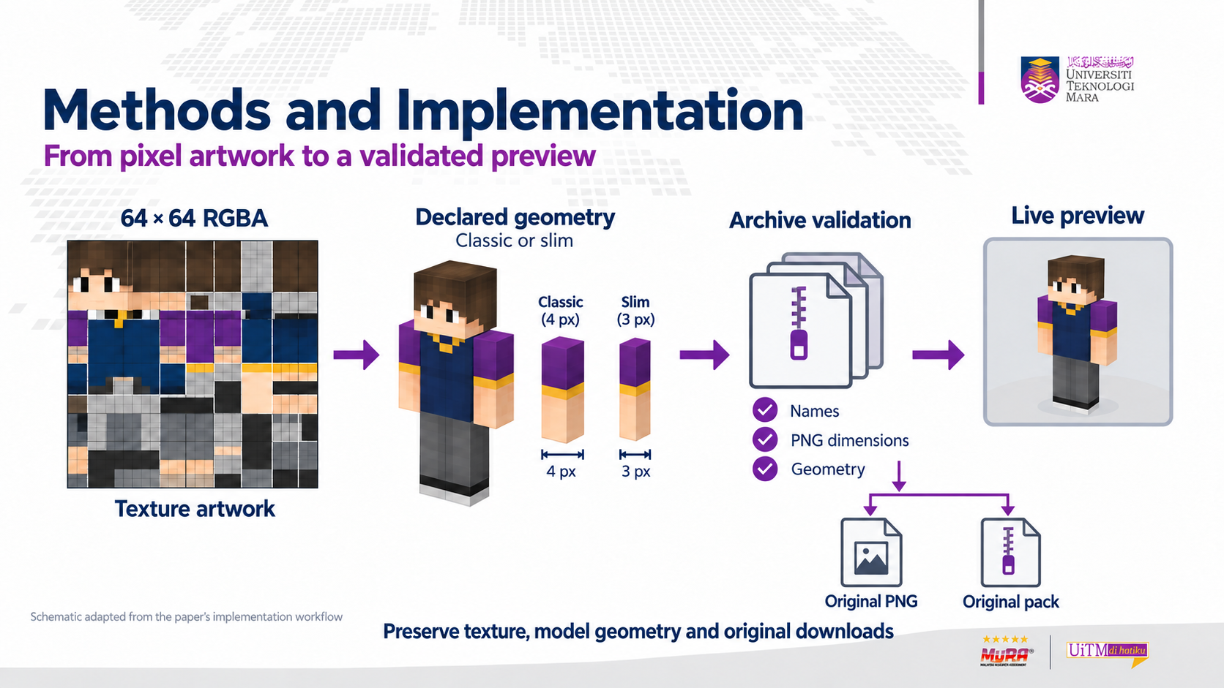
Notes:
Read the workflow from left to right. The starting point is pixel artwork drawn on the Steve and Alex templates. Each inspected asset is a 64-by-64 RGBA image. The texture regions map onto the head, torso, arms and legs, with transparent outer layers available for selected details. The pictured texture is a schematic explanation, not an extracted original asset.
Classic and slim geometry must be declared explicitly. Their different arm widths affect how the same texture regions align on the model. Archive definitions connect the texture filename, geometry and localisation key, and language files supply the displayed name.
Validation resolves those labels, checks PNG signatures and dimensions, and extracts original assets for the preview. The download branches preserve the original PNG and pack, rather than exporting a rendered screenshot. The reported web pack matches the source SHA-256. The archive inspected in the paper was 84,544 bytes, or approximately 82.6 KiB.
Source: paper Section III-A/B and Fig. 1. Methods diagram adapted for presentation. Microsoft skin-pack documentation is source-paper reference [4]. Established implementation tools include fflate for archive preparation. Diagram symbols and texture are schematic.

Slide 7
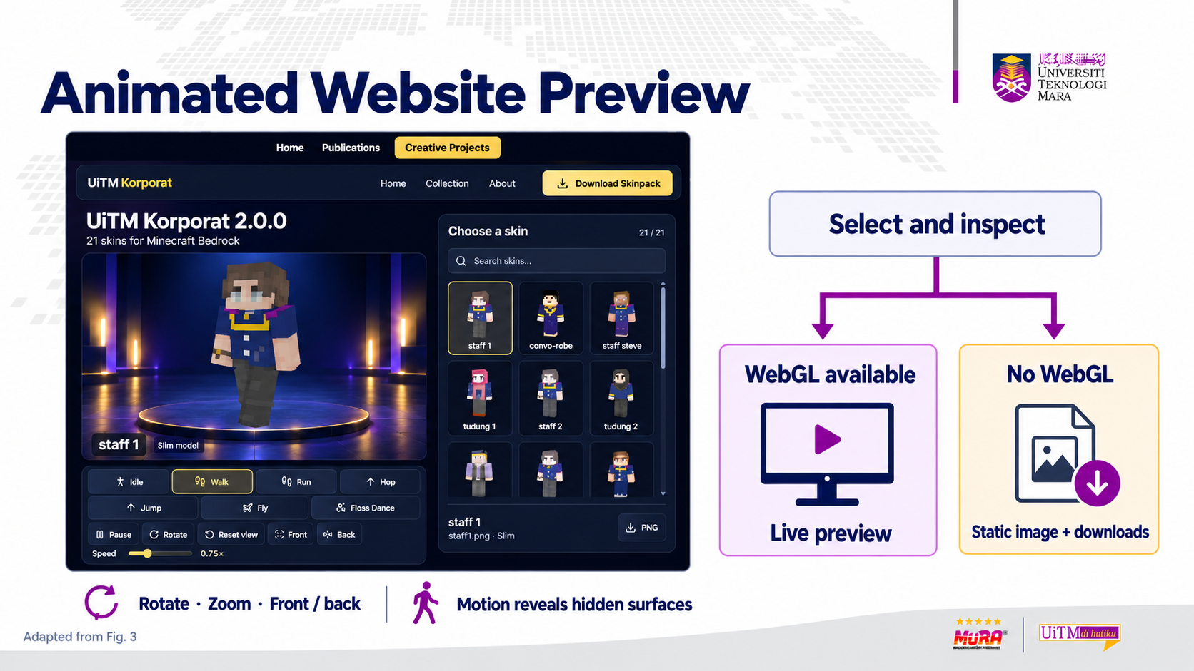
Notes:
The source screenshot shows staff 1, with slim geometry and Walk selected at 0.75× speed. Selecting a gallery entry loads its texture and declared geometry into one live model. A request identifier prevents an earlier selection from replacing a newer one when loading completes out of order.
Rotation, zoom and front/back views reveal different garment faces. Walk, Run and the other poses expose sleeve and leg surfaces as limbs move. Pause and speed controls allow closer inspection. These animations belong to the viewer model. The downloaded PNG contains appearance data and does not introduce a new gameplay animation.
The small branch diagram shows the fallback: if WebGL is unavailable, a static image and downloads remain accessible. Reduced-motion defaults also retain a still-view option. The paper offers a rationale for informed appearance selection, while a measured benefit to UiTM users remains future work.
Source: paper Section III-C, Figs. 2–3. React, TypeScript, Vite and skinview3d 3.4.2 are the reported viewer stack. Source Fig. 3 screenshot © 2026 Mohammad Hafiz bin Ismail, CC BY-SA 4.0. The slide panel is an illustrative adaptation of the interface; image generation may resample or reinterpret small visual details. The unchanged original screenshot is available in assets/figures/fig3-skin-studio.png. Use that original for exact interface or pose inspection. Public studio: https://mypapit.net/uitm-minecraft-skins/.

Slide 8
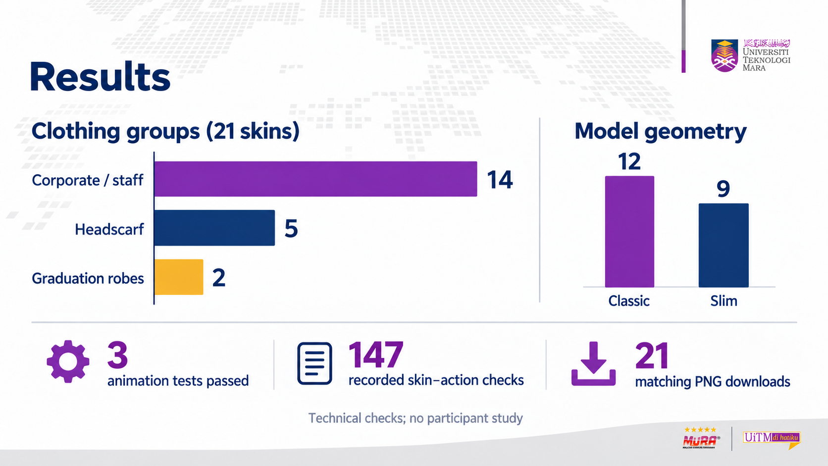
Notes:
The bars summarise the catalogue rather than a participant sample. Fourteen skins are corporate or staff-themed variants, five are headscarf variants, and two are graduation robes. Across the same collection, twelve use classic geometry and nine use slim geometry. Both classifications total twenty-one, but they describe different properties of the assets.
The technical evidence has several sources. Three custom-animation tests passed in the initial review. Saved development records document 147 skin-action checks and 21 matching PNG downloads, together with responsive checks and a forced static fallback. The focused public-site inspection observed selection and download controls, but did not repeat the entire suite.
These records support technical behaviour and asset integrity. They do not establish participant recognition, satisfaction or educational outcomes, and the slide does not imply a new overall pass-rate measurement.
Source: paper Section III-B, Table I and Section IV. All displayed values are directly reported counts. No participant study was conducted.

Slide 9
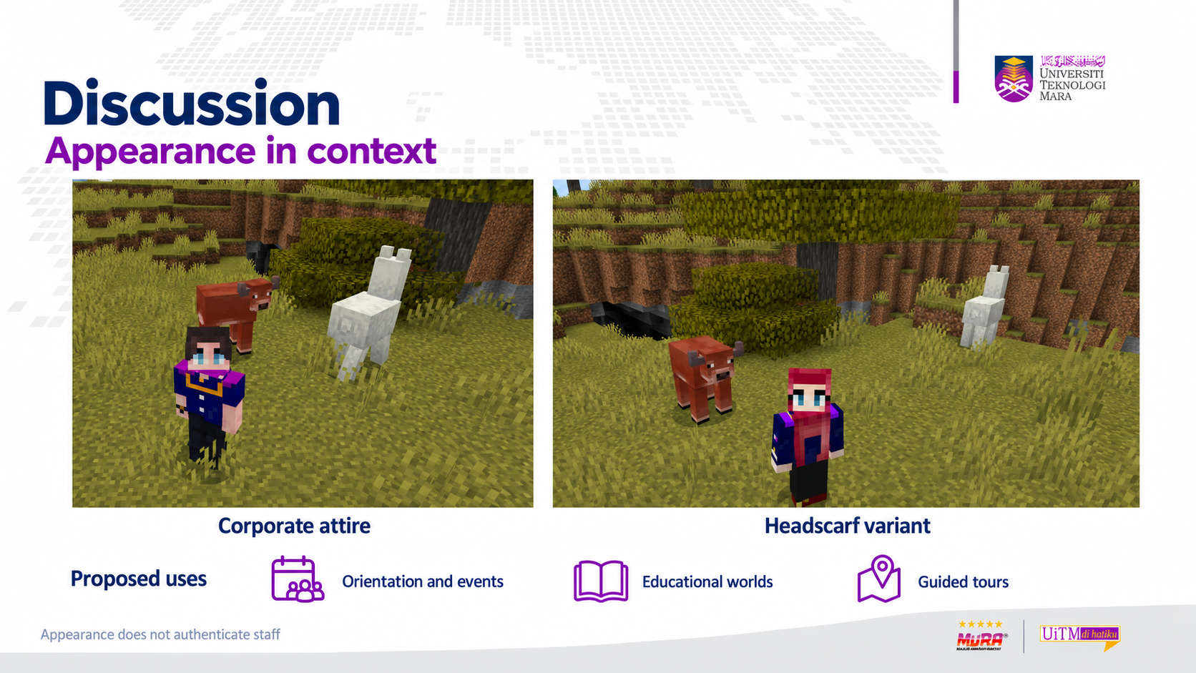
Notes:
The two original screenshots show corporate attire and a headscarf variant within the game world. They document appearance in context; they are not observations of a collaborative learning activity. Exact selection identifiers are not available for these images.
The paper proposes several applications: orientation and institutional events, learning activities in custom worlds, and guided tours of reconstructed environments. These are possible uses to evaluate. Any educational value would also depend on task design, feedback, reflection and the information supplied by the environment.
Representation also needs care. The collection provides a stylised set of choices rather than a demographic model of UiTM employees. Hair, headscarves, beards and model geometry do not determine a user’s gender. Likewise, a skin cannot authenticate employment, rank or a hosting role. Player names and assigned roles would need to identify guides or event staff.
Source: paper Section V and Figs. 4(b)–4(c). Proposed educational uses draw on source-paper references [12]–[15]; they are not evaluated outcomes of this artifact. Screenshots © 2026 Mohammad Hafiz bin Ismail, CC BY-SA 4.0; adapted with captions.

Slide 10
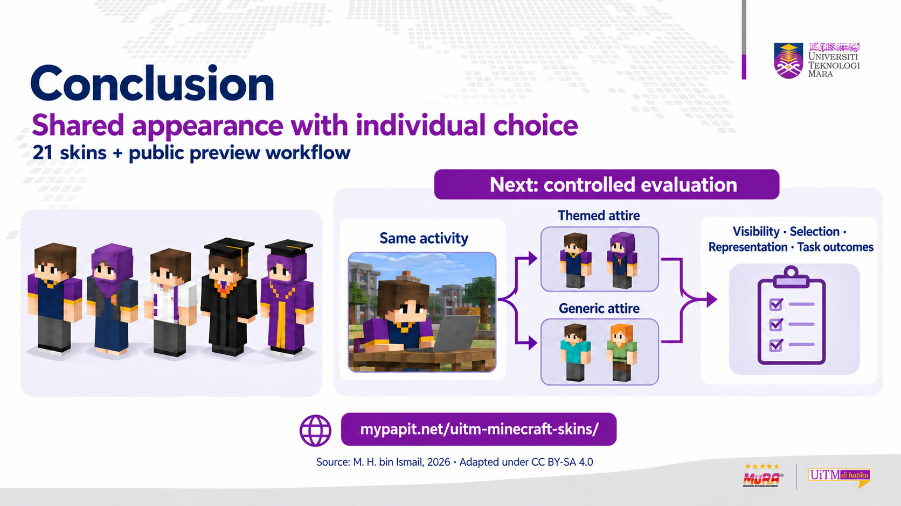
Notes:
The artifact brings together twenty-one institution-themed skins, a catalogue that retains original labels, and a public archive-derived preview workflow. Its design combines shared garment themes with individual selection. The documented checks establish aspects of implementation and visible appearance.
The next step is direct evaluation. The proposed comparison holds the activity constant and varies themed versus generic attire. Useful measures include visibility, appearance-selection accuracy and time, perceived representation, and task or tour outcomes. This would help separate the contribution of attire from the effect of the activity itself.
Recognition, collaboration and learning benefits remain to be measured. The studio address provides access to the artifact for inspection and reuse.
Source: paper Sections V-C and VI. The two-condition diagram is a proposed evaluation design, not a completed experiment. Source paper © 2026 Mohammad Hafiz bin Ismail, CC BY-SA 4.0, https://creativecommons.org/licenses/by-sa/4.0/. This adapted presentation is shared under CC BY-SA 4.0. Paper: https://mypapit.net/pub/pdf/representation-uitm-institutional-identity-corporate-attire-minecraft-avatars.pdf. Studio: https://mypapit.net/uitm-minecraft-skins/.

